Slide 1
HEART DISEASE ANALYSIS
Presented By Sai Krishna Tandasi

Slide 2
Contents
Introduction
Problem Statement
Process
Dashboard
Insights
Conclusion

Slide 3
Introduction
The Heart disease diagnostic Analysis aims to provide the comprehensive overview on presence and absence of the Heart disease but on the given parameters and provide insights that involves the reasons for the Heart disease.
age: The person's age in years
sex: The person's sex (1 = male, 0 = female)
cp: The chest pain experienced (Value 1: typical angina, Value 2: atypical angina, Value 3: non-anginal pain, Value 4: asymptomatic)
trestbps: The person's resting blood pressure (mm Hg on admission to the hospital
chol: The person's cholesterol measurement in mg/dl

Slide 4
Introduction
fbs: The person's fasting blood sugar (> 120 mg/dl, 1 = true; 0 = false)
restecg: Resting electrocardiographic measurement (0 = normal, 1 = having ST-T wave abnormality, 2 = showing probable or definite left ventricular hypertrophy by Estes' criteria)
thalach: The person's maximum heart rate achieved
exang: Exercise induced angina (1 = yes; 0 = no)
oldpeak: ST depression induced by exercise relative to rest
slope: the slope of the peak exercise ST segment (Value 1: upsloping, Value 2: flat, Value 3: down sloping)
ca: The number of major vessels (0-3)
thal: A blood disorder called thalassemia (3 = normal; 6 = fixed defect; 7 = reversable defect)
target: Heart disease (0 = no, 1 = yes)

Slide 5
Problem Statement
Health is real wealth in the pandemic time we all realized the brute effects of covid-19 on all irrespective of any status. You are required to analyze this health and medical data for better future preparation.
Do ETL: Extract- Transform and Load data from the heart disease diagnostic database
You can perform EDA through python. The database extracts various information such as
Heart disease rates, Heart disease by gender, by age.
You can even compare attributes of the data set to extract necessary information. Make the necessary dashboard with the best you can extract from the data. Use various visualization and features and make the best dashboard
Find key metrics and factors and show the meaningful relationships between attributes.

Slide 6
Process
Data Understanding
Understood the data and found Key Performance Indicators (KPIs) of the data
Data Cleaning
Removed unnecessary columns which have no impact in KPIs
Data Analysis
Derived dominant categories in each KPI(Area and Production) with various filters
Uncovering Insights
Created visual Dashboards showing the impact of various sectors influencing the KPIs
Excel, Power Query
Derived some key visual insights
Python, Pandas, Seaborn
Microsoft Power BI

Slide 7
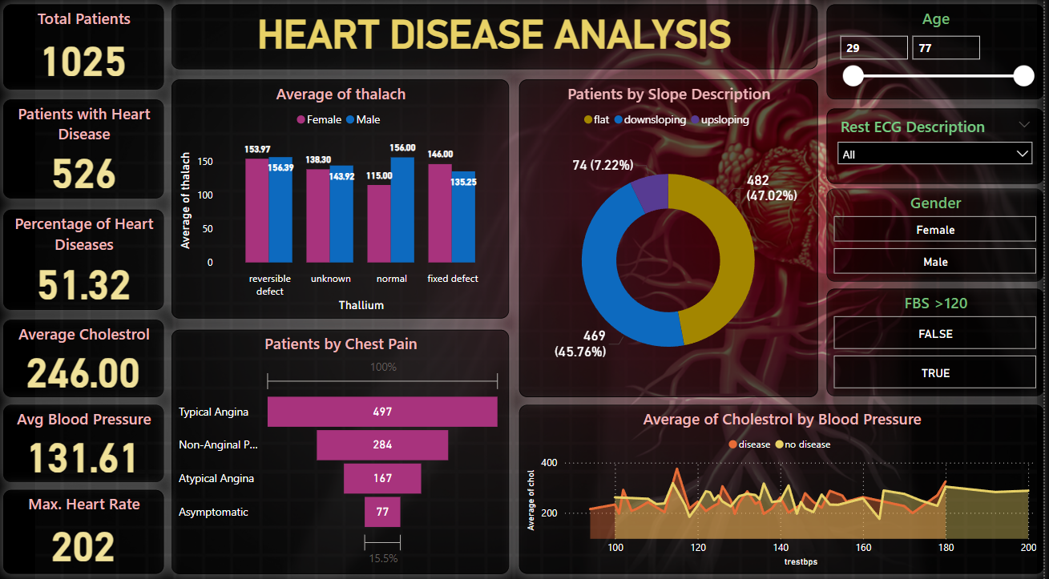
Dashboard

Slide 8
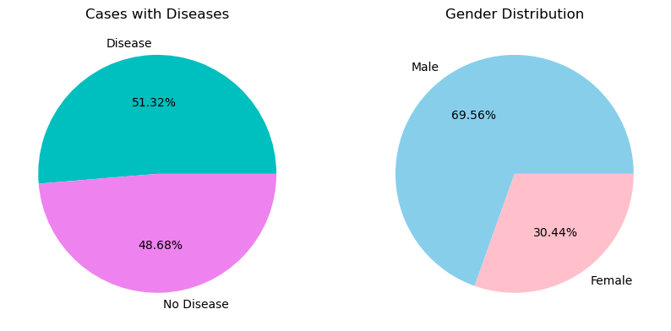
Insights
From All Cases Almost more than of the people are suffering with Heart Disease.
Males are suffering with heart diseases more than Females.
Almost 70% males are suffering with Heart Disease.

Slide 9
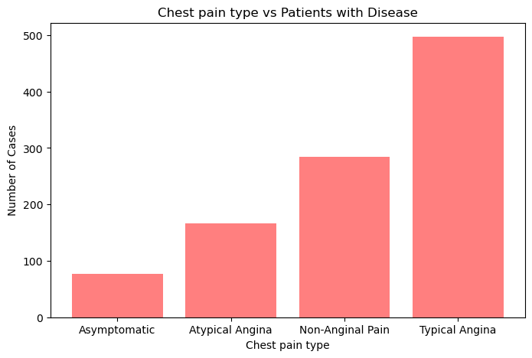
Insights
Patients with Typical Anginal Pain have more chance of getting Heart Disease.
Cases with Asymptomatic pain have less chance of getting heart Disease.
Patients are also suggested to take necessary treatment during the Asymptomatic Pain.

Slide 10
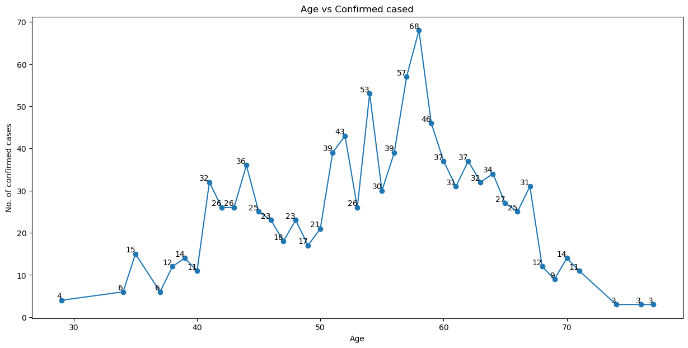
Insights
Patients with age in between 55 to 65 have high chance of getting Heart Disease.
Sudden raise in line shows that there is significant change when age enters into 55.
Also Patients with young age have less chance of getting Heart Disease.

Slide 11
Conclusion
From the analysis on Heart Disease we can observe :
From the overall population, people having heart disease (51.3%) are lesser than those who have heart disease(48.7%)
More Males are prone to ST depression as compare to females.
Middle Age People are most affected by Heart Disease AND Old Age People are mostly FREE from any kind of Heart Disease.
Males are more prone to Heart Disease than the Females.
People having Typical Angina chest pain have a higher chance of heart disease.
Higher number of men are suffering from Typical Angina type of Chest Pain.
There is very high number of Typical Angina Chest Pain in old age Category
Blood Pressure increases between age of 50 to 60 and somehow continue the pattern till 70.
Similarly Cholesterol Increasing in the age group of 50-60 and continue till 70.
We can observe from here that ST depression mostly increases between the age group of 30-40.
Power BI Link: https://app.powerbi.com/links/vYyIW7r-cD?ctid=209a70f5-a678-4831-9798-ea1ea04aa9b8&pbi_source=linkShare

